Slide 1

Design of a UPC/ScanTron Reader
Kathleen E. Williams
Valparaiso University
Notes:
Hi my name is Kathleen and I will be presenting today the Design of a UPC/Scantron Reader. This presentation will be an OVERVIEW of the design process as exemplified by my junior final design project.

Slide 2
The Design Process
Conceptualization
Electronic Prototype
Implementation
Notes:
An Overview of the Design Process.
Three main components of the design process
Conceptualization: Understanding the problem
Electronic Prototype: Computer simulation of expected hardware performances
Implementation: Conversion to the hardware components and final product

Slide 3
Conceptualization
Understand the Problem
  Purpose of Design
  Users
  Inputs
  Outputs
  Operating Conditions
Notes:
The most important and beginning step of the design process is to understand the problem. To understand the problem you need to know what the purpose of the design should be. Why will this device be created? Also, another important consideration are the users. This device can be designed to be used by children, adults, disabled people, or perhaps to run autonomously. Inputs and outputs are the holes that are made in the mysterious black box and depend on the purpose of the design. And lastly the operating conditions are important for reasons such as power consumption, reliability, and longevity of the device. Now we will see how Conceptualization can be applied to the UPC/ScanTron Reader.

Slide 4


ScanTron Reader Conceptualization
Understanding the Problem
Eight Questions & Answers
Feeder
Compare Results
Users
Teachers with limited technology abilities
Inputs
Keyboard Input (Start and Stop)
Sensor Readings
Outputs
Printer Feeder Control
LED Display of Progress
Screen Display of Results
Notes:
Miss Sunshine teaches 4th grade and needs a fast way to administer and grade her weekly quizzes. She has requested that the Scantron form will have a maximum of 8 entry fields for students to pencil in darkly. She must be able to put all the forms in an automatic feeder system and be able to view the results on the screen where she can print them out.
The users of the device will be teachers who do not have degrees in electrical engineering. They need a nice easy-to-understand program interface. The menu design of the software program must be simplified.

Slide 5

UPC Conceptualization
Understanding The Problem
Expedite Groceries
Infrared Scanner
Quick
Reliable
Compare to Database of Products
Easy Display and Menu
Inputs
Sensor Readings
Start and Stop Buttons
Outputs
Register Menu
Product Database

Slide 6
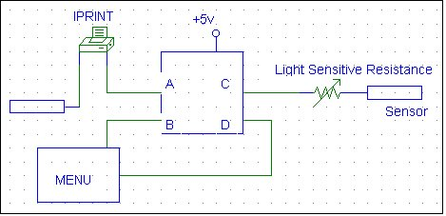
System Devices & Components
Sensors
Printer Feeder
Data Forms
Display Monitor (BUFFALO Interface)
Microcontroller (Motorola MC 68HC11 )

Slide 7
Motorola MC 68HC11
  Embedded Microcontroller
  Input and Output Directly From Device
  Little Human Interaction
  Low Power Consumption
  Memory (ROM,RAM,EPROM,EEPROM)
  Input/Output Ports
Notes:
The 68HC11 is a powerful 8-bit data, 16-bit address microcontroller from Motorola with an instruction set that is similar to the older 68xx (6801, 6805, 6809) parts. Depending on the variety, the 68HC11 has built-in EEPROM/OTPROM, RAM, digital I/O, timers, A/D converter, PWM generator, and synchronous and asynchronous communications channels (RS232 and SPI). Typical current draw is less than 10mA.

Slide 8
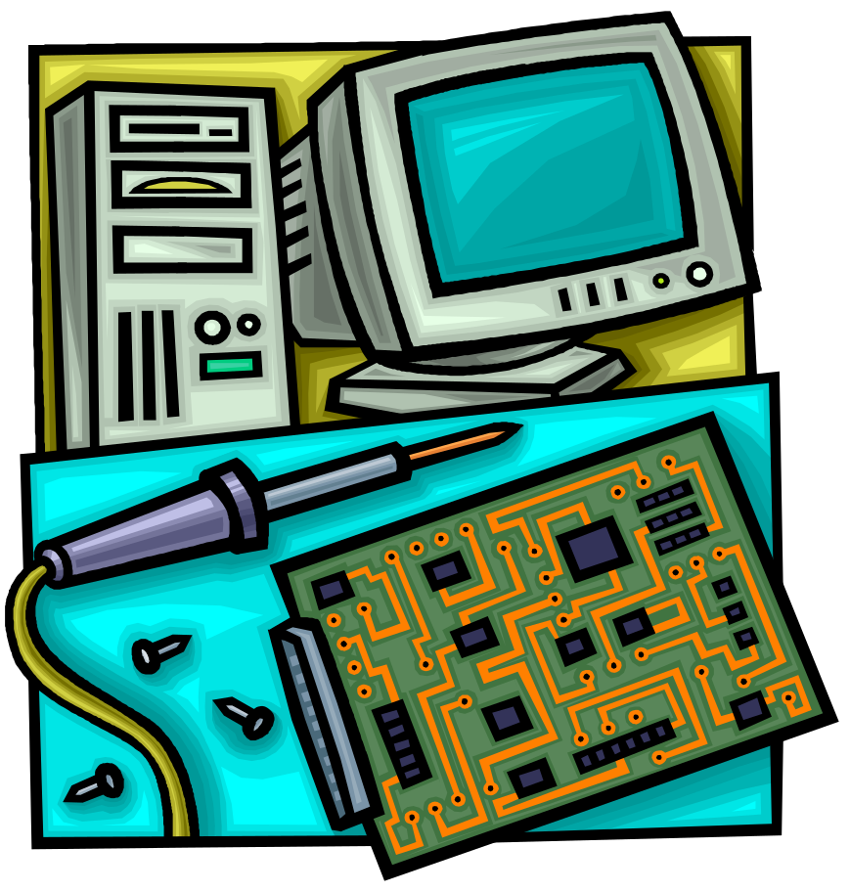
Electronic Prototype
Similar Prototype
Motorola HC11 Assembly Language
Menu and Output Displays
Databases
Processing Algorithms
Simulation Programs
Case Testing
Debugging

Slide 9
Implementation
Similar Implementations
Product Verification
User Testing and Review
Stress Testing
Maintenance

Slide 10
Questions ?
E-mail: Katie.Williams@valpo.edu

